Slide 1
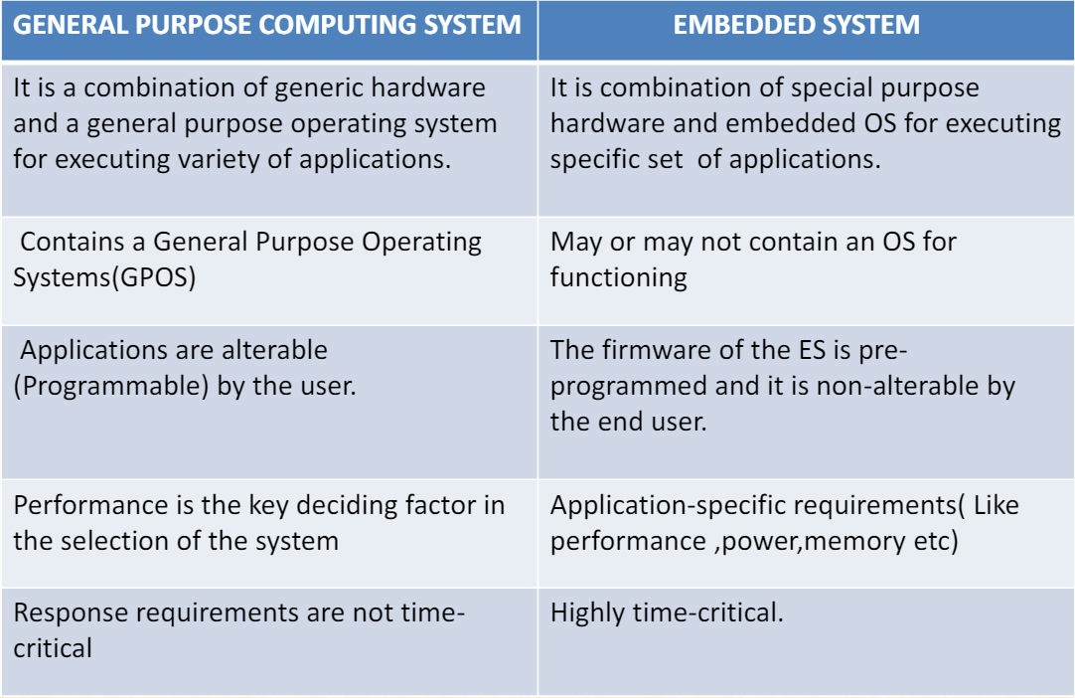
Embedded Systems vs. Computing Systems

Slide 2
Embedded Systems vs. Microcontrollers
Embedded systems and microcontrollers are important components in modern electronics. Their unique qualities and uses distinguish them separate, even if both are essential to the creation of intelligent, automated solutions. This article explores the applications, flexibility, complexity, and architecture of microcontrollers and embedded systems and offers a thorough comparison to help you better comprehend them.

Slide 3
Embedded Systems vs Microcontrollers: Key Differences
Architecture
Embedded systems are sophisticated configurations comprising multiple components, including microcontrollers, microprocessors, sensors, actuators, and other peripherals. These systems integrate hardware and software to perform complex, dedicated functions within larger systems. The architecture of an embedded system is designed to handle diverse tasks, often requiring multiple processing units and various peripheral interfaces to interact seamlessly.
Microcontrollers, on the other hand, are single-chip solutions that consolidate the CPU,
memory (RAM and ROM), and peripheral interfaces within one integrated circuit. This consolidation simplifies the design, making microcontrollers highly efficient for specific control tasks. The architecture of a microcontroller is optimized for real-time operations, featuring separate program and data memory spaces to enhance processing speed and efficiency.

Slide 4
Flexibility
Embedded systems are renowned for their high flexibility. They can be extensively customized to meet the specific requirements of various applications. This adaptability is achieved through the careful selection of hardware components and the development of tailored firmware. Embedded systems can range from simple single-function devices to complex multifunctional systems, making them suitable for a broad spectrum of applications across different industries.
In contrast, microcontrollers are less flexible but excel in efficiency for specific tasks. Their
design focuses on performing predefined control functions reliably and efficiently. While they lack the broad adaptability of embedded systems, microcontrollers are ideal for straightforward, real-time control tasks where extensive customization is unnecessary.

Slide 5
Complexity
The complexity of embedded systems varies widely. Simple embedded systems may involve a single microcontroller performing basic operations, while more complex systems might integrate multiple processors, extensive memory, and a variety of peripheral devices to manage sophisticated functions. This scalability allows embedded systems to be implemented in both simple and highly complex applications.
Microcontrollers, however, are inherently simpler. They are designed for tasks that require less complexity and can be executed within the constraints of a single chip. This simplicity is advantageous in applications requiring reliable, efficient control without the need for additional complexity.

Slide 6
Applications
Embedded systems find applications across a myriad of industries due to their versatility and adaptability:
Automotive Industry: Embedded systems manage engine control, infotainment systems, safety features like airbags and ABS, and advanced driver-assistance systems (ADAS).
Medical Devices: Embedded systems power critical medical equipment such as MRI
machines, pacemakers, and portable diagnostic devices, ensuring precision and reliability.
Consumer Electronics: Devices like smartphones, smart TVs, and home automation systems rely on embedded systems for enhanced functionality and seamless user experiences.
Industrial Automation: Embedded systems drive automation in manufacturing
processes, controlling machinery, monitoring systems, and optimizing production efficiency.

Slide 7
Applications
Microcontrollers, while less versatile, are integral to applications requiring efficient, single-task control:
Home Appliances: Microcontrollers manage functions in appliances like microwaves, washing machines, and refrigerators, ensuring efficient operation and user convenience.
Wearable Devices: In wearables such as fitness trackers and smartwatches, microcontrollers handle sensor data, display interfaces, and communication modules.
Remote Controls: Microcontrollers are the backbone of remote control devices,
providing precise and responsive control for TVs, air conditioners, and other electronic devices.
IoT Devices: In the Internet of Things (IoT) ecosystem, microcontrollers facilitate communication, data processing, and automation in smart devices.

Slide 8
Conclusion
While embedded systems and microcontrollers share a common foundation in computing technology, their distinct architectures, flexibility, and applications make them suitable for different roles in the technology landscape. Embedded systems, with their complex and customizable architecture, are ideal for applications requiring high flexibility and adaptability. Microcontrollers, with their simplicity and efficiency, excel in specific control tasks where reliability and straightforward operation are paramount. Understanding these differences is crucial for designing efficient and effective solutions across various fields.

